Slide 1
BeijingHouseCluster
Applied Data Science Capstone Project
Tianxuan Chen

Slide 2
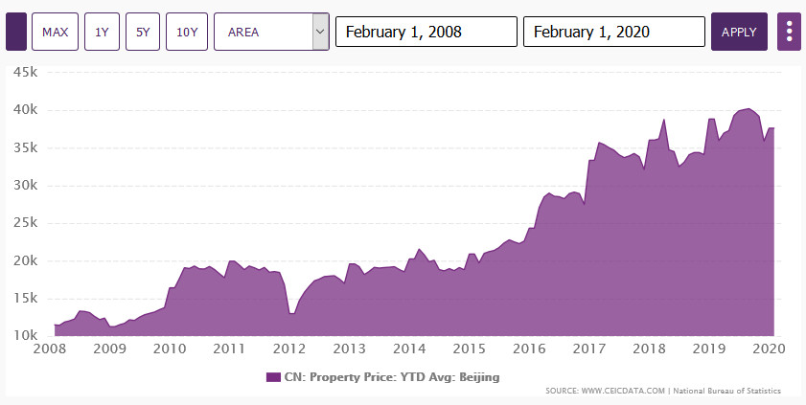
Purpose: Cluster Beijing Houses For Different Types of People
House price of Beijing has almost quadrupled From 2008 to now. However, people's purchasing power has not changed much.
As one of the metropolises in the world, Beijing has 16 districts and covers around 6336 square miles.
The Population Density of Beijing is 20,462,610
In this project, I will cluster houses in Beijing in order to find suitable houses for different types of people.

Slide 3
Data: Aquisition
Our cluster analysis including 7 main factors:
  areas
  price
  house type: new or second-hand
  number of hospitals
  number of schools
  number of subways
  distance to city center
Data are collected from two website: LianJia and AMap.
Lianjia https://bj.lianjia.com/ including: areas, price and house type data
AMap: https://lbs.amap.com/ including: number of hospitals, number of schools, number of subways and distance to city center

Slide 4
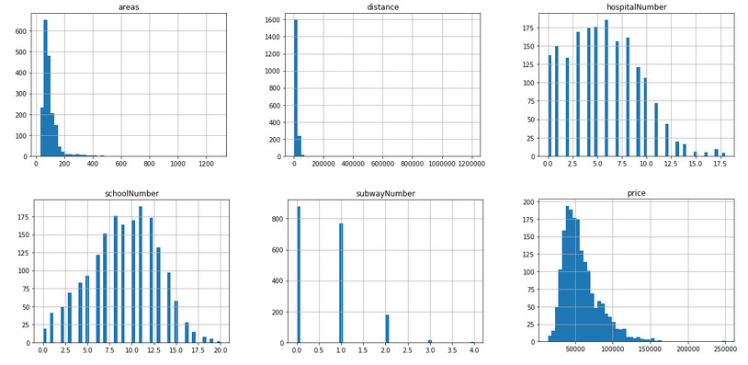
Data: Cleaning
After aquisition, we have 1947 rows data.
Using Histogram display how data distribute and remove those outliers
After Cleanning, we now have 1898 rows valid data.

Slide 5
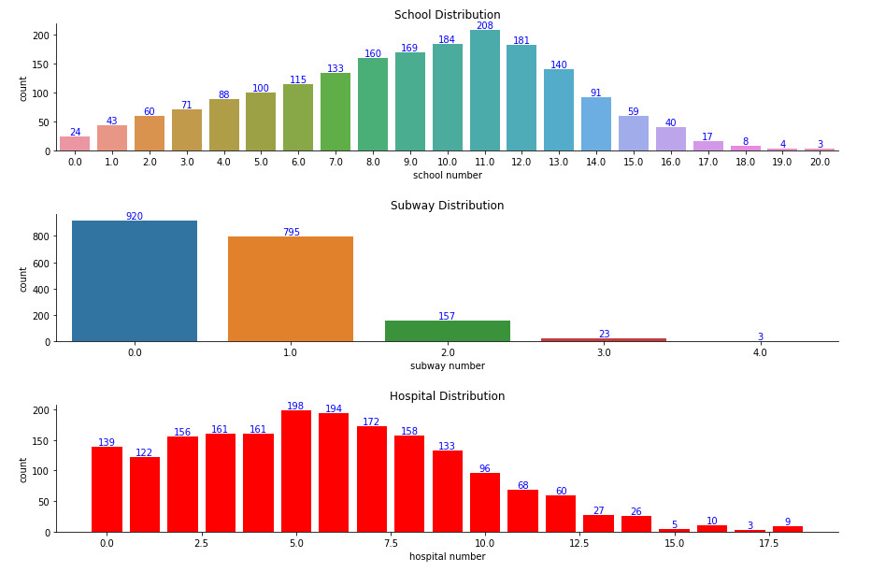
Data: Visualization
Let’s see how features affect our price
The following picture shows the distribution of Schools, Subways and Hospitals

Slide 6
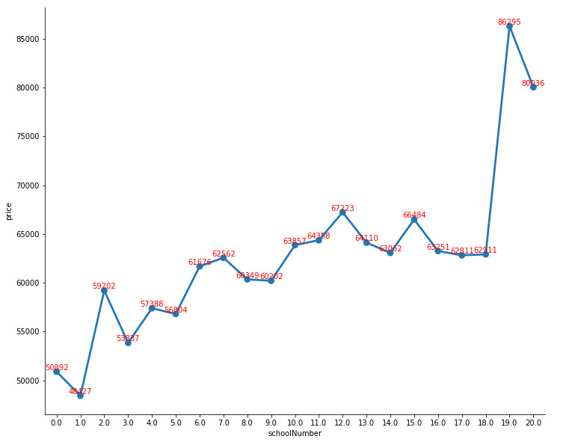
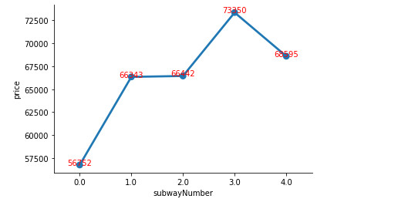
Data: Visualization
Through drawing line graph of number of schools or subway stations and price, we can simply conclude that as the number of schools or subways increase, the higher the price goes.

Slide 7
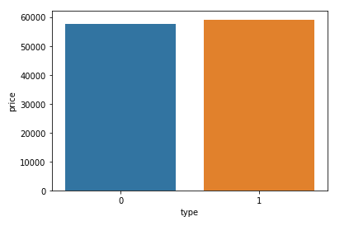
Data: Visualization
Categorical data like house type, by comparing their average price, they are very close. It seems like weather the house is new or second-hand, it wont affect price as much as we think.

Slide 8
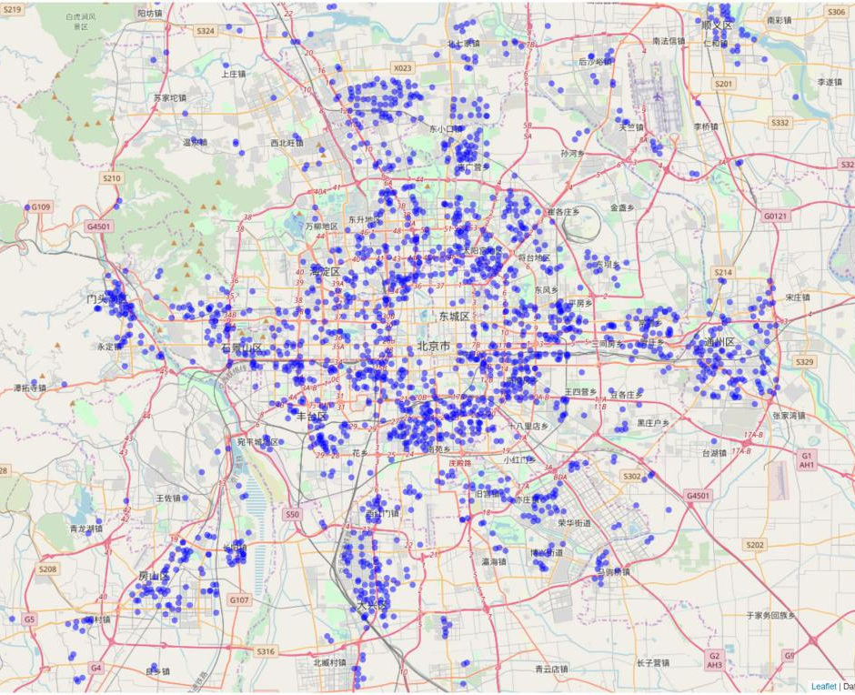
First glimpse of data in Beijing Map
Using folium library to distribute all houses data in Beijing map
Obviously, the distribution of the house spreads from the center to the surroundings

Slide 9
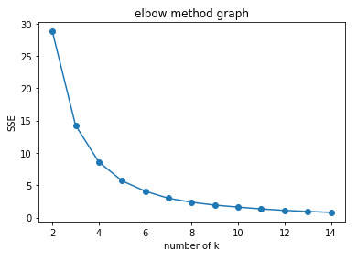
Finding the best number of clusters
I used a loop function to see the SSE from 2 clusters to 14 clusters
The following figure shows how the SSE change while number of clusters increasing.
According to Elbow method, it is obviously to conclude that the best cluster number is 5.

Slide 10
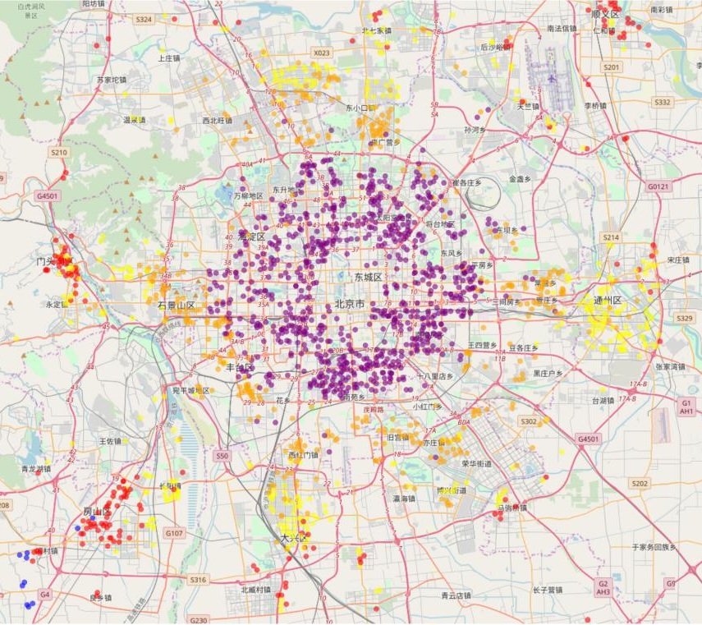
Showing different clusters in Beijing Map
Cluster 1 has best city resources but highest price.
Cluster 2 is cheap but too far away.
The price of Cluster 3 and Cluster 5 are similar but Cluster 5 has better public resources than Cluster 3.
Cluster 4 outliers, some of them are mension with extremely high price.

Slide 11
Conclusion
Based on previous analysis, we can say features like areas, number of schools, subways and hospitals are positve correlated with house price. Distance is negative correlated with house price. As for house type, it does affect house price much.
This project gives me a basic understanding of clustering, I am pretty satisfied with the results. In fact, there are more factors need to be considered to cluster houses such as land agent company, loan interest rate, number of bedrooms and etc.
Due to the limitation of my ability of data collection, I won’t be able to implement all my thoughts this time. In the future, I would try to re-do this project by adding more factors and optimizing the model and parameters.

